Slide 1
Deloitte Purchase-to-Pay Process Review
April 24, 2024

Slide 2
Agenda
Issues with Purchase-to-Pay (P2P) Process
Goods Received Analysis
Early Payments Analysis
Recommendations
Questions

Slide 3










P2P Process Issues
Delayed Goods Received
The company is experiencing significant delays in the receipt of goods, causing subsequent setbacks in the procurement cycle.
Working Capital Challenges
Early payments are severely limiting working capital availability, restricting the company’s ability to channel funds into growth opportunities.
Order Placement
Goods Receival
Invoice Received
Clear invoice
PR
Submission
PR/PO Change Events
PO sent to
Supplier
PO Change
Events
Goods Received
GR as per Supplier Invoice
Change Events
AP process
Payment
Supplier Receive Payment
Process
Notes:
Limited liquidity is restricting the company’s ability to channel funds into growth opportunities.
Operational Bottleneck: Extended lead times observed from purchase initiation to goods receipt are affecting production schedules.
Resulting Issue: Inefficiencies in the procurement process are leading to delayed availability of essential raw materials, impacting timely production.
: Unlock additional cash flow to enable investment in other strategic business areas

Slide 4


Flows with Friction Points
.
Change events
PROCUREMENT
& SOURCING
Date mismatch
Inventory Verification
Quantity mismatch
Material/Service Order approval
Supplier Negotiation
Payment Block
Cost mismatch
Based on requirement PR
is generated
Supply/Demand
Assessment
Change Contract
Set Payment Block
PR is approved/Reject
Shipment preparation
Change delivery date
Remove Payment Block
Allocation of material
for production
Clear invoice
Purchase Request
Create Purchase Order (PO)
Send PO to Vendor
Goods Receipt
Record Invoice Receipt
Clear Invoice
Supplier takes time to prepare the order
Supply Chain Risk analysis
Order Placement
Supplier submit invoice for payment. Payment is done based on payment terms.
Pre-planning of material
Transit Time to R & D
shipments to company
Qualification, testing, compliance check
Participation of SC team
Order Acceptance
Quality check
STRATEGIC PLANNING, EXECUTION AND STRATEGY DEVELOPMENT
Preparation of Order
Material/Service receival
l Confirmation
RFQ, Supplier
verification
Payment Terms
SUPPLIER

Slide 5
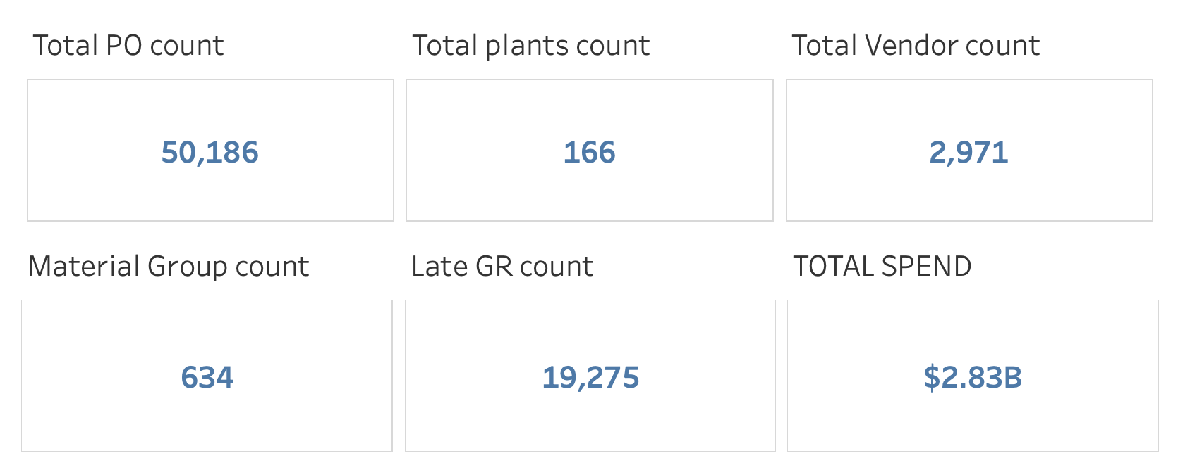
Supply Chain Delays
Challenge in supply chain operations: 25% of our POs are delivered at least 3 days later than the expected delivery date, causing significant disruptions in our production schedule.

Slide 6
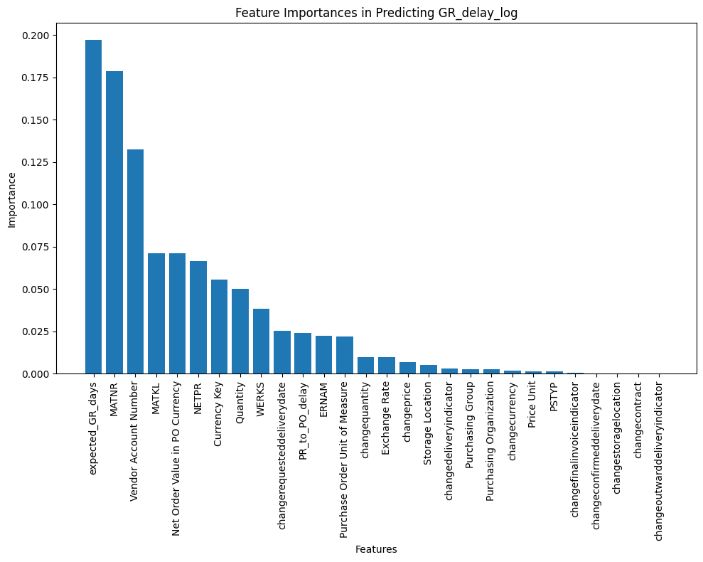
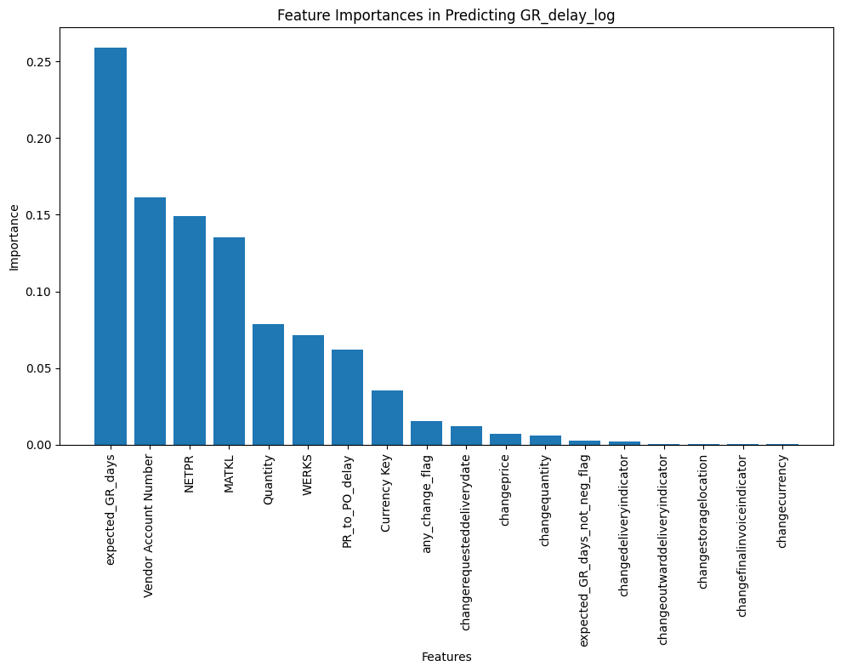
Critical Variables for Regression Model
Objective: Our goal is to understand the factors of the business that contribute to late goods receipts, identify the underperforming and overperforming subsets, and propose a strategic solution to predict delay.

Slide 7
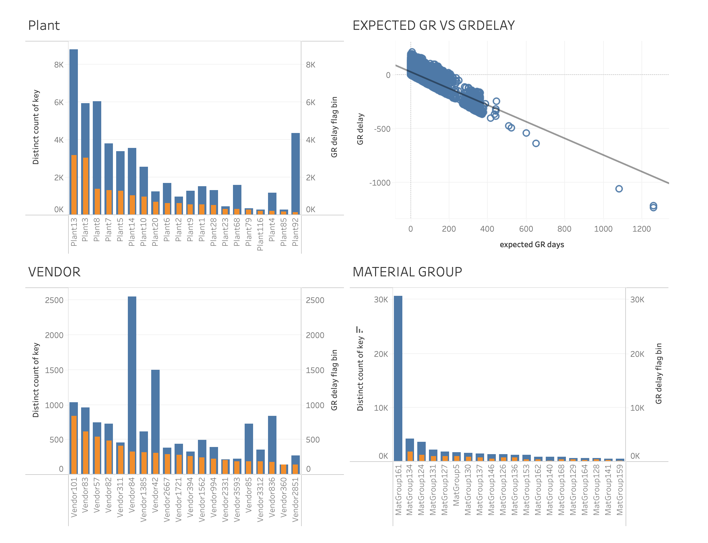
Opportunities Realized from Machine Learning

Slide 8
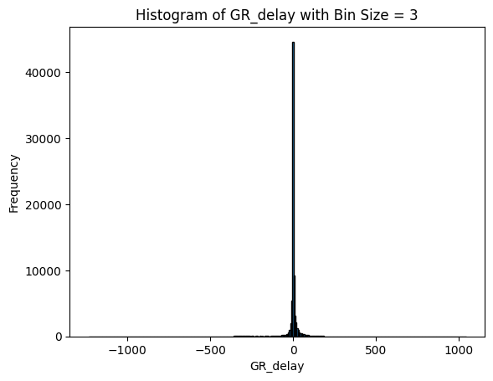
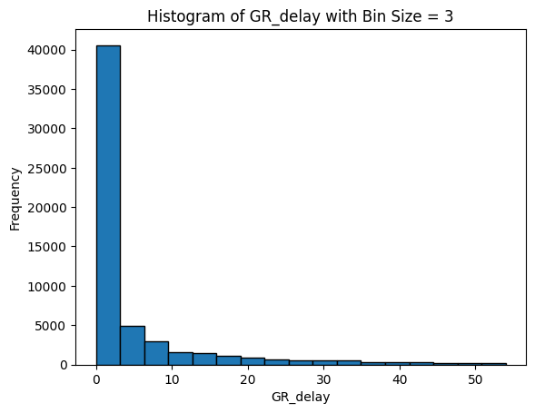
Data Transformation and Classification Model
GR_delay_flag binned for pattern analysis
Quantity: PO_order_value/unit_price
PR-to-PO time: Measures procurement speed
Outlier handling: 3<GR_delay<54
Impressive accuracy of 90% in predicting Goods Received delays
Enabling proactive management
Better vendor relations
Predicts based on just early PO-PR information
Notes:
*Payments falling on W-F

Slide 9
Opportunities Realized from Machine Learning
Plants 13 and 3 consistently struggle with late deliveries, with over 30% of Purchase Orders (POs) delayed. Conversely, Plant 92 boasts a strong on-time delivery record with delays under 5%.
Vendors 101, 83, 57, and others frequently deliver goods late, with over 80% of orders facing delays. This identifies clear opportunities for negotiation or revisiting sourcing strategies.
Material Group 161 demonstrates excellent on-time delivery. Analyzing their procurement practices could yield valuable lessons to optimize processes across other material groups.
Establishing unambiguous delivery schedules with vendors is crucial for accurate inventory management and reliable production forecasting.

Slide 10
Early Payments Trends
Process: The practice of paying invoices prior to their scheduled due dates.
Frequency of payments:
~24% of payments are consistently made ahead of time.
Payment are done on an average 4 days early.
Working capital reduced
Opportunity cost: unable to reinvest working capital in operations

Slide 11
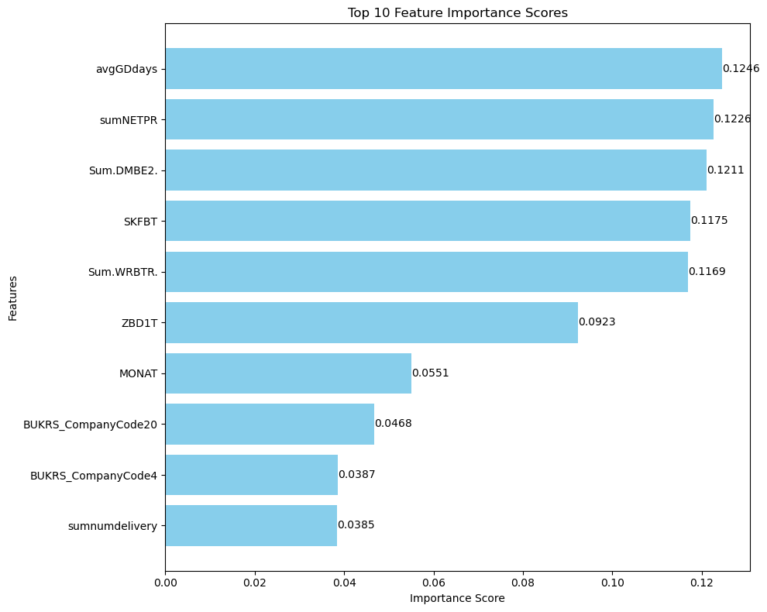
Identifying Key Drivers of Early Payments
Random forest to identify key features.
Backward stepwise reduction to refine model for best accuracy
Logistic regression model to predict impact of features on early payments

Slide 12
Drivers of Early Payments
Key predictors for early payments
Payment method: indicator method 2 more likely
Invoice amount: large are more likely to be paid early
Average GDdays: negative
Majority of early payments are made on Monday and Tuesday

Slide 13
Recommendations
Establish monitoring/oversight of certain KPIs to collect sufficient data to fully diagnose problems.
Process flow modifications:
Introduce automation to standardize payment cycles.
Develop system to streamline purchasing process.
Review vendor payment terms for possible areas of optimization.
Introduce and track vendor performance reviews.
Notes:
* Review supply chain logistics to account for potential bottlenecks that create downstream delays

Slide 14
Questions?

Slide 15
Appendices

Slide 16
Appendix A: Data Cleaning
Early payments data.
Handling Missing Values - There was missing data in the dataset​. Missing data rows were dropped as number was not significant.
Outlier Detection - Detect outliers in numerical columns that may impact the analysis. Handled as per context of the variable, including GR_delay column.
Table Join – Tables were joined for further analysis.
GR data analysis,
delivery_schedule_lines_df, scheduling_agreement_schedule_lines_df, purchase_requisition_df, purchasing_document_header_df, purchasing_document_item_df, delivery_schedule_lines_df, scheduling_agreement_schedule_lines_df, purchase_requisition_df, purchasing_document_header_df, purchasing_document_item_df

Slide 17
Appendix A: Calculated fields
merged_df['expected_GR_days'] = (pd.to_datetime(merged_df['expected_delivery_date']) - pd.to_datetime(merged_df['createtime'])).dt.days
merged_df['GR_delay'] = merged_df['GDdays'] - merged_df['expected_GR_days']
merged_df['GR_delay_flag'] = merged_df['GR_delay'].apply(lambda x: 1 if x > 0 else 0)
merged_df['GDdays_log'] = np.log(merged_df['GDdays'] + 1)
merged_df['GR_delay_log'] = np.where(merged_df['GR_delay'] > 0, np.log(merged_df['GR_delay'] + 1), 0)
data['any_change_flag'] = data[change_columns].sum(axis=1)
merged_df['expected_GR_days_bin'] = pd.cut(merged_df['expected_GR_days'], bins=bins, labels=labels, right=False)
merged_df['GR_delay_bin'] = pd.cut(merged_df['GR_delay'], bins=bins_neg, labels=labels_neg, right=False)
merged_df['GDdays_bin'] = pd.cut(merged_df['GDdays'], bins=bins, labels=labels, right=False)
merged_df['GR_delay_flag_bin'] = merged_df['GR_delay_bin'].apply(lambda x: 1 if x > 1 else 0)

Slide 18
Appendix B: Early Payment Analysis
Random Forest
Methodology:
Random Forest Implementation: Employed Random Forest to analyze and rank the importance of features based on their impact on early payment.
2.Selection Criteria: Features with the highest importance scores were selected for further analysis.
Results:
Successfully isolated critical predictors for early payment through the Random Forest model.
Accuracy of RF Model: 81.1%

Slide 19
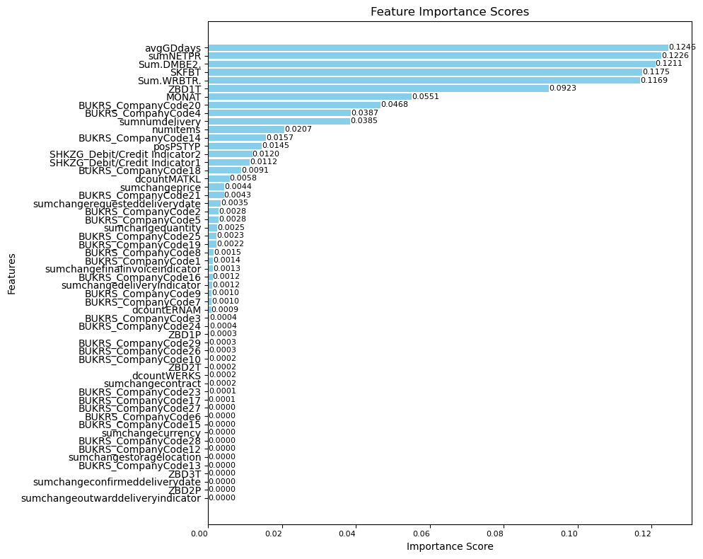
Appendix C: Feature Importance Scores

Slide 20
Appendix D: Selected Features - Random Forest
ZBD1T
SKFBT
Sum.DMBE2.
Sum.WRBTR.
MONAT
numitems
avgGDdays
sumNETPR sumnumdelivery
BUKRS_CompanyCode2
BUKRS_CompanyCode4

Slide 21
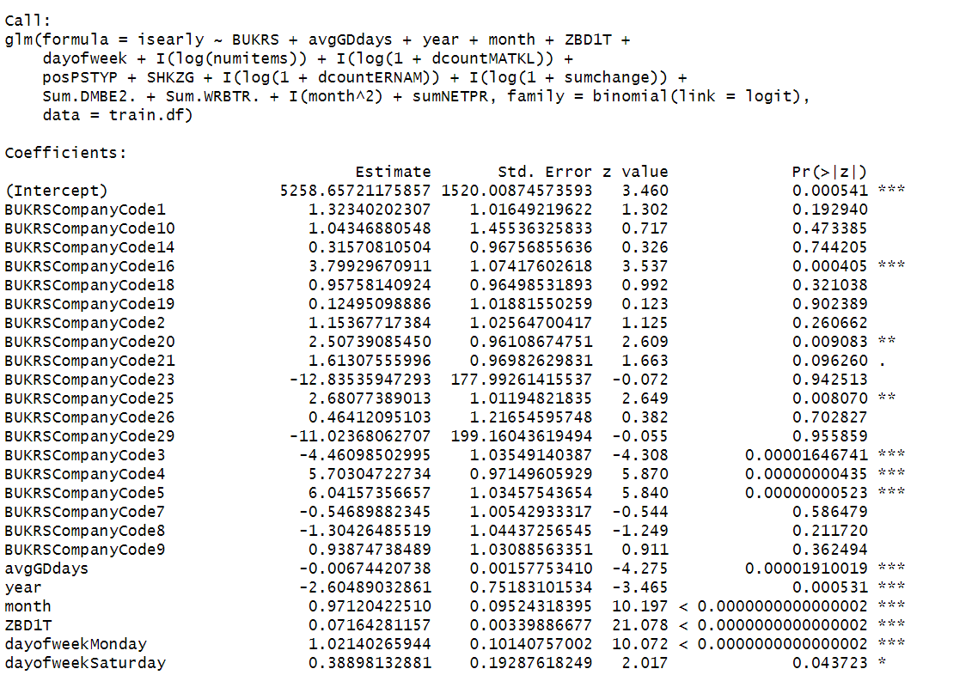
Appendix E: Summary of Model 1

Slide 22
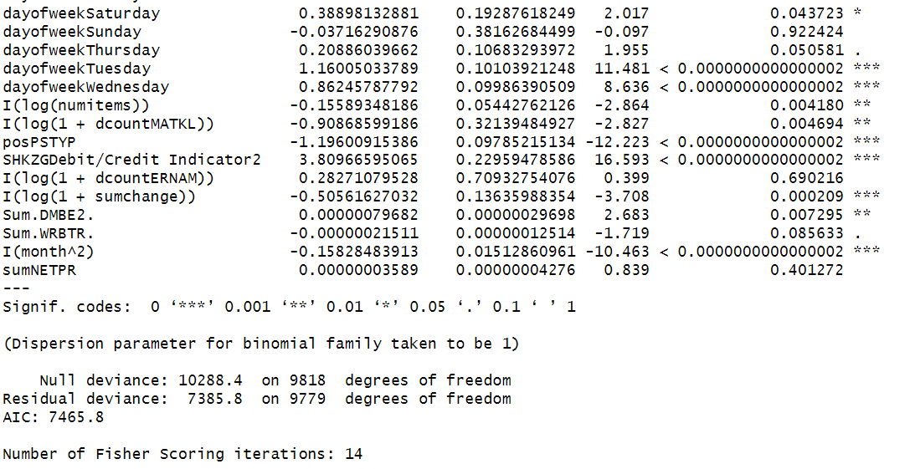
Appendix F: Summary of Model 2

Slide 23
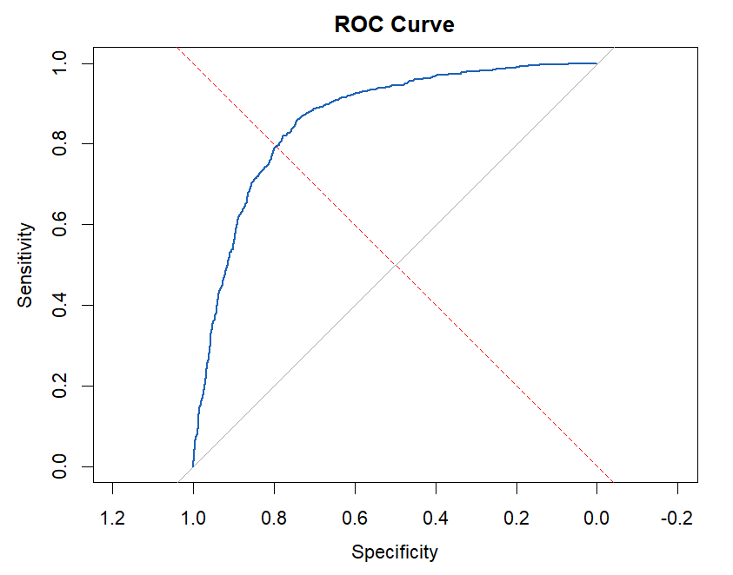
Appendix G: Logistic Regression Model Evaluation
Accuracy: 82.2%
Precision: 66.9%
Recall: 43.9%
Error: 17.7%
AUC: 86%
More information in Early_Payments.R

Slide 24
Appendix H: GR-data Regression analysis
LinearRegression Performance:
Mean CV MSE: 0.8707607612535803
Mean CV RMSE: 0.9331052086712235
Mean CV MAE: 0.6910124683031859
Mean CV R²: 0.03486465215143815
Ridge Performance:
Mean CV MSE: 0.8707706003865902
Mean CV RMSE: 0.9331103780917609
Mean CV MAE: 0.6910228951094772
Mean CV R²: 0.03485433859497755
Lasso Performance:
Mean CV MSE: 0.8839530239051397
Mean CV RMSE: 0.9401435527699796
Mean CV MAE: 0.7097666091571838
Mean CV R²: 0.020258649597984024
RandomForestRegressor Performance:
Mean CV MSE: 0.40985081497993103
Mean CV RMSE: 0.6400544968004769
Mean CV MAE: 0.3321749156994421
Mean CV R²: 0.545874512801362
GradientBoostingRegressor Performance:
Mean CV MSE: 0.6266317653456862
Mean CV RMSE: 0.7915662897340058
Mean CV MAE: 0.5040380143620764
Mean CV R²: 0.3054480778911931
SVR Performance:
Mean CV MSE: 0.9484376562545285
Mean CV RMSE: 0.9738366921779834
Mean CV MAE: 0.6546686263530554
Mean CV R²: -0.051236282495652305

Slide 25
Appendix I: GR-data classification analysis
total records in data 57253
Accuracy: 0.9035908900377253
Confusion Matrix:
[[10242 583]
[ 797 2692]]
Classification Report:
precision recall f1-score support
0 0.93 0.95 0.94 10825
1 0.82 0.77 0.80 3489
accuracy 0.90 14314
macro avg 0.87 0.86 0.87 14314
weighted avg 0.90 0.90 0.90 14314

